Slide 1
Solar panel optimization
Gustav Nikopensius,
Martin Leissoo, Lauri Lopp

Slide 3
Our goal

Slide 4
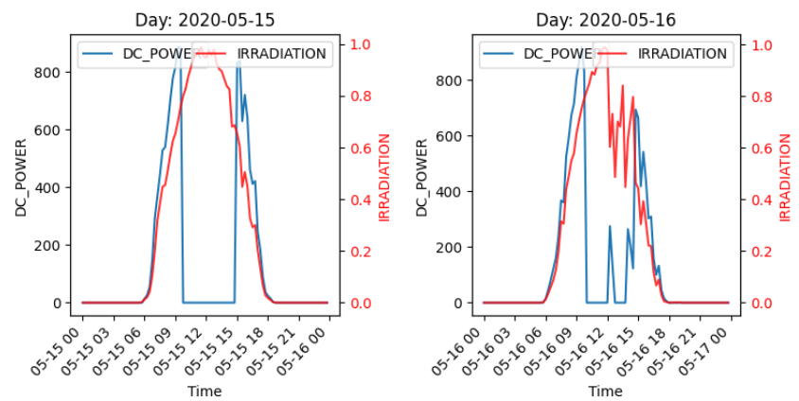

Slide 5
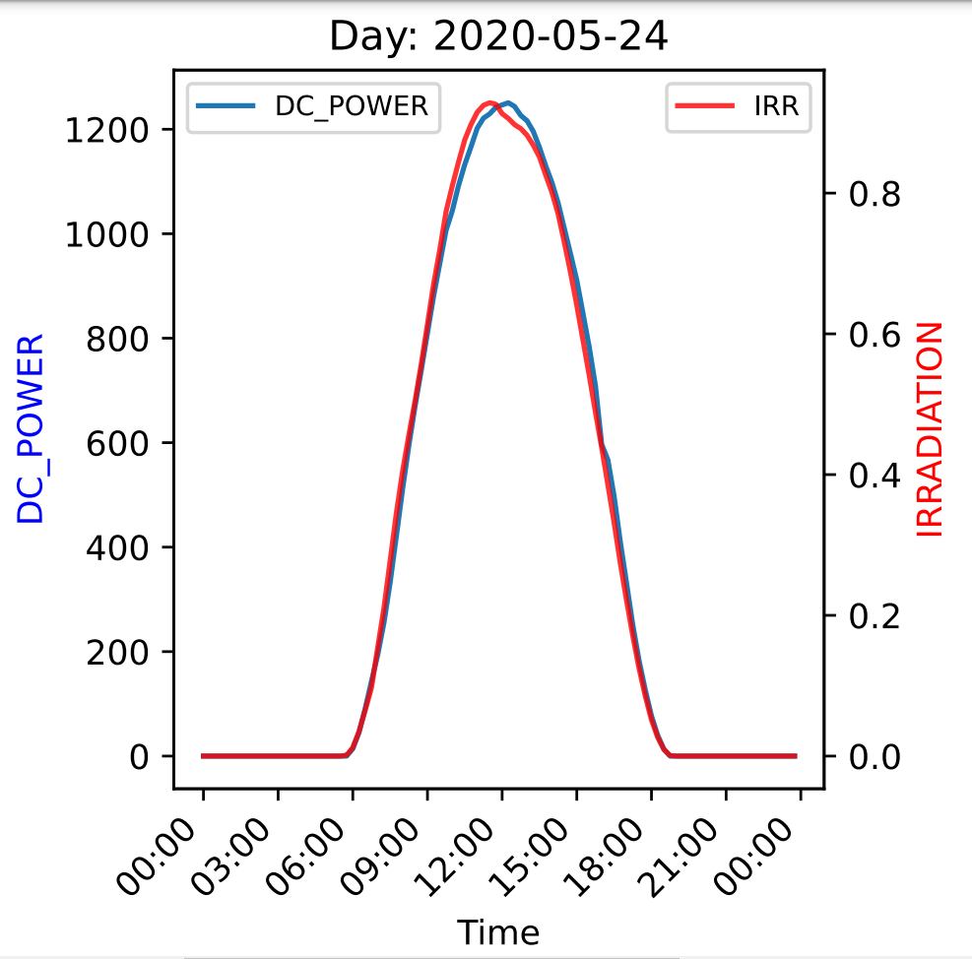
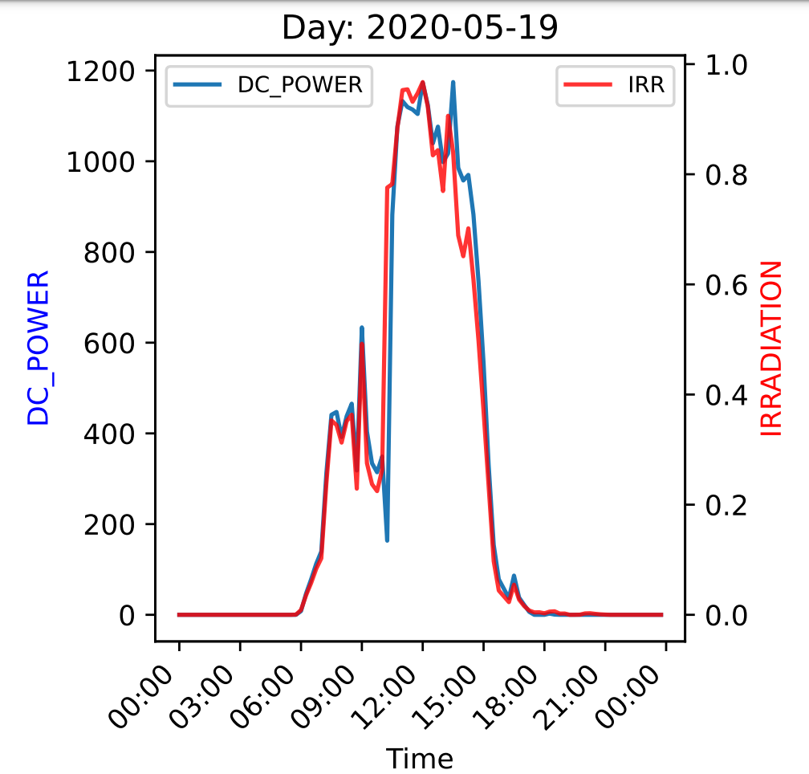
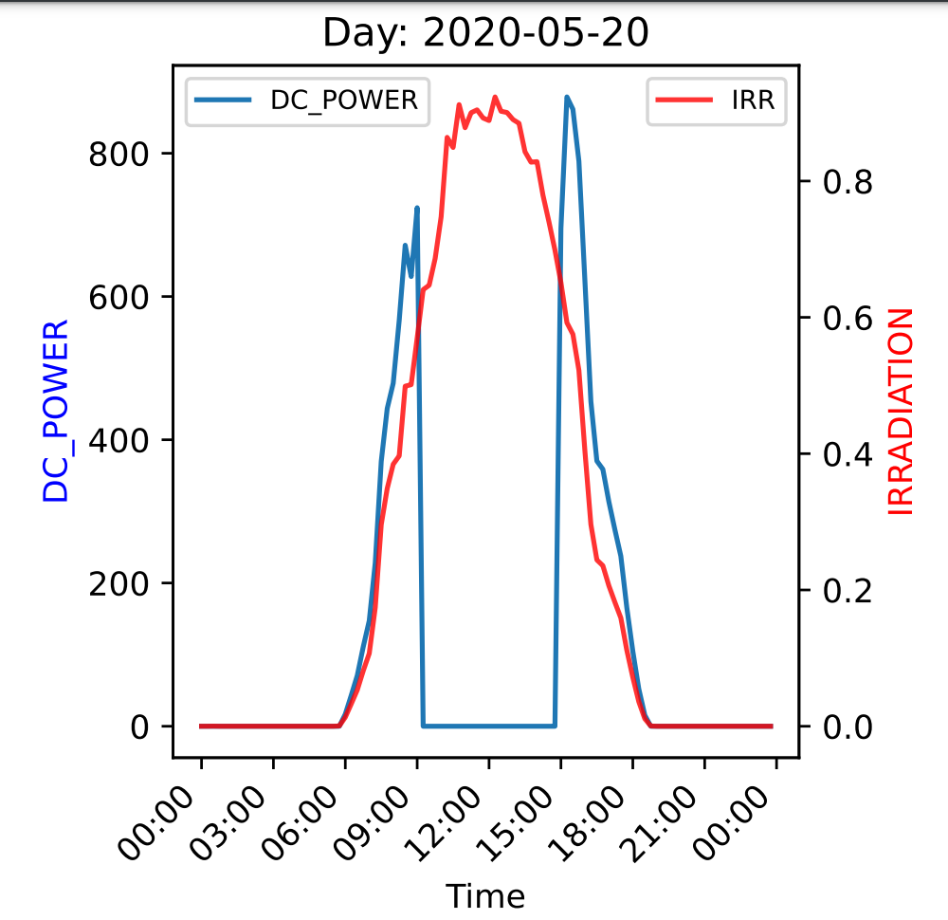

Slide 6
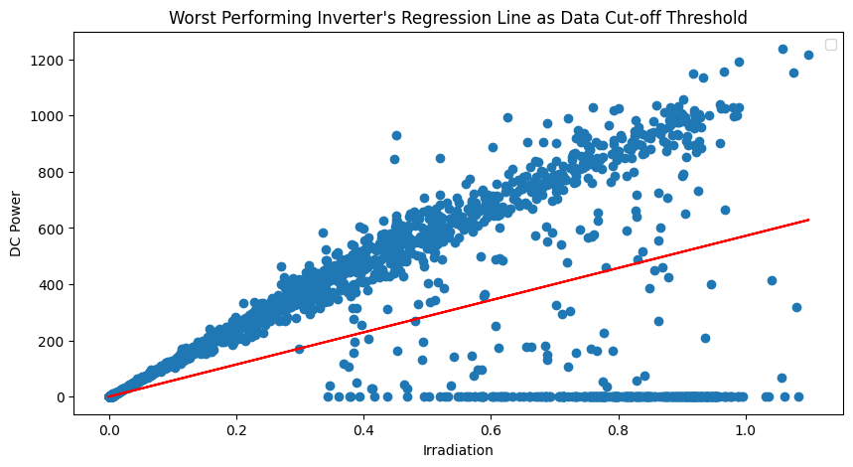

Slide 8
Table of contents
01
02
03
Introduction
Guide
Culture
04
05
06
The science
Decorating
Recipe
You can describe the topic of the section here
You can describe the topic of the section here
You can describe the topic of the section here
You can describe the topic of the section here
You can describe the topic of the section here
You can describe the topic of the section here

Slide 9
Whoa!
This can be the part of the presentation where you introduce yourself, write your email…

Slide 10
Introduction
You can give a brief description of the topic you want to talk about here. For example, if you want to talk about Mercury, you can say that it’s the smallest planet in the entire Solar System

Slide 11
01
Introduction
You can enter a subtitle here if you need it

Slide 12
The slide title goes here!
Do you know what helps you make your point clear? Lists like this one:
They’re simple
You can organize your ideas clearly
You’ll never forget to buy milk!
And the most important thing: the audience won’t miss the point of your presentation

Slide 13
The slide title goes here!
Do you know what helps you make your point clear? Lists like this one:
They’re simple
You can organize your ideas clearly
You’ll never forget to buy milk!
And the most important thing: the audience won’t miss the point of your presentation

Slide 15
History and culture
Mercury is the closest planet to the Sun and the smallest one in the entire Solar System. This planet's name has nothing to do with the liquid metal, since Mercury was named after the Roman messenger god. Despite being closer to the Sun than Venus, its temperatures aren't as terribly hot as that planet's. Its surface is quite similar to that of Earth's Moon, which means there are a lot of craters and plains
Speaking of craters, many of them were named after artists or authors who made significant contributions to their respective fields. Mercury takes a little more than 58 days to complete its rotation, so try to imagine how long days must be there! Since the temperatures are so extreme, albeit not as extreme as in Venus, and the solar radiation is so high, Mercury has been deemed to be non-habitable for humans

Slide 16
Themes and inspiration
Mercury
Venus
Mercury is the closest planet to the Sun and the smallest one in the Solar System—it’s only a bit larger than the Moon
Venus has a beautiful name and is the second planet from the Sun. It’s hot and has a poisonous atmosphere

Slide 17
Gingerbread house literature
Mercury
Venus
Mars
It’s the closest planet to the Sun and the smallest in the Solar System
Venus has a beautiful name and is the second planet from the Sun
Despite being red, Mars is actually a cold place. It’s full of iron oxide dust

Slide 18
Psychology and sociology
Venus
Neptune
Mars
Saturn
Venus is the second planet from the Sun
It’s the farthest planet from the Sun
Despite being red, Mars is a cold place
It is a gas giant and has several rings

Slide 19
Variations
Mercury
Venus
Mars
Jupiter
Saturn
Neptune
It’s the closest planet to the Sun
Venus is the second planet from the Sun
Mars is actually a very cold place
Jupiter is the biggest planet of them all
It’s composed of hydrogen and helium
It’s the farthest planet from the Sun

Slide 20
Gingerbread house style
Feature | Description | Example
Gingerbread trim | Mercury the closest planet to the Sun
Steeply pitched roof | Venus has a beautiful name but it’s very hot
Colorful facade | Jupiter is the biggest planet in the Solar System

Slide 21
Awesome words

Slide 22
— Someone Famous
“This is a quote. Words full of wisdom that someone important said and that can inspire the reader”

Slide 23
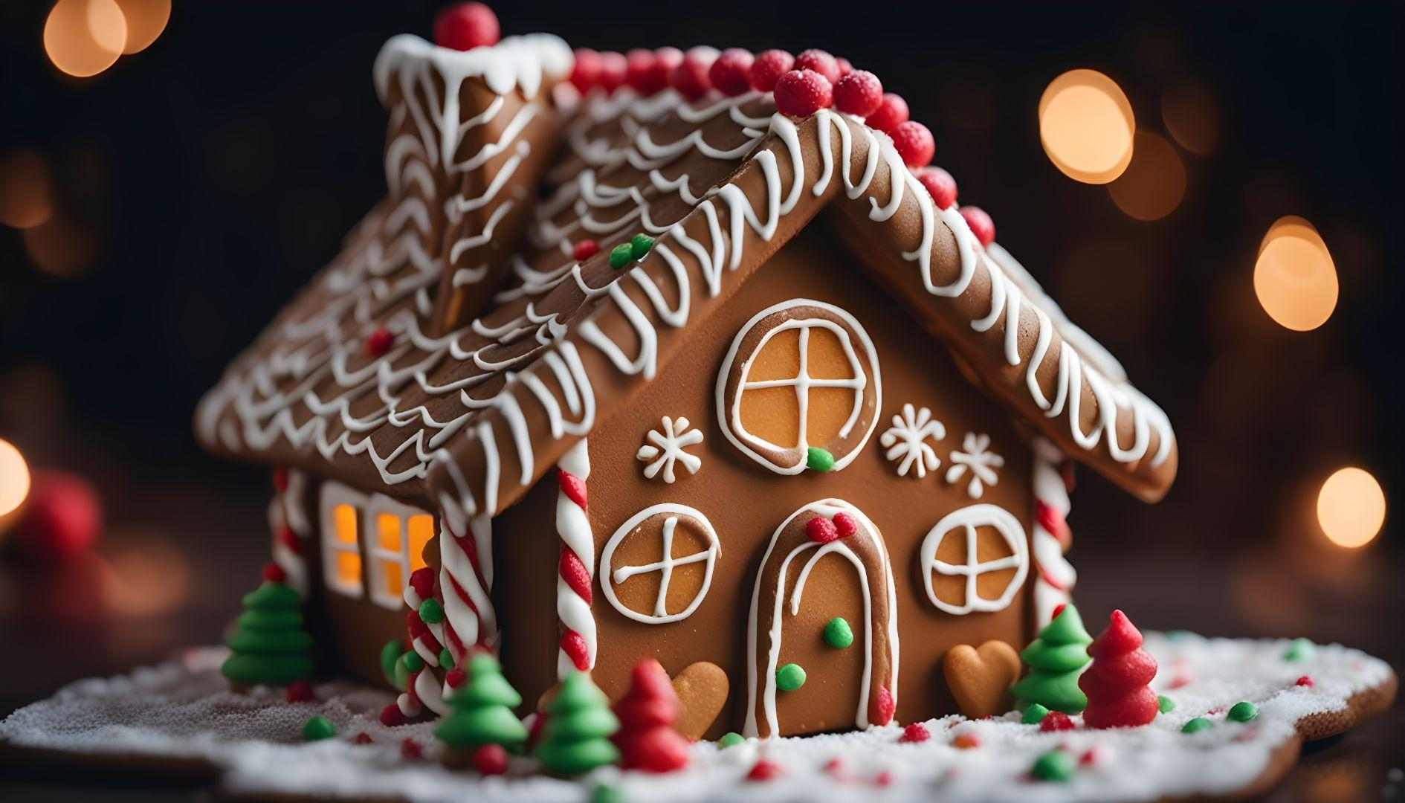
A picture is worth a thousand words

Slide 24
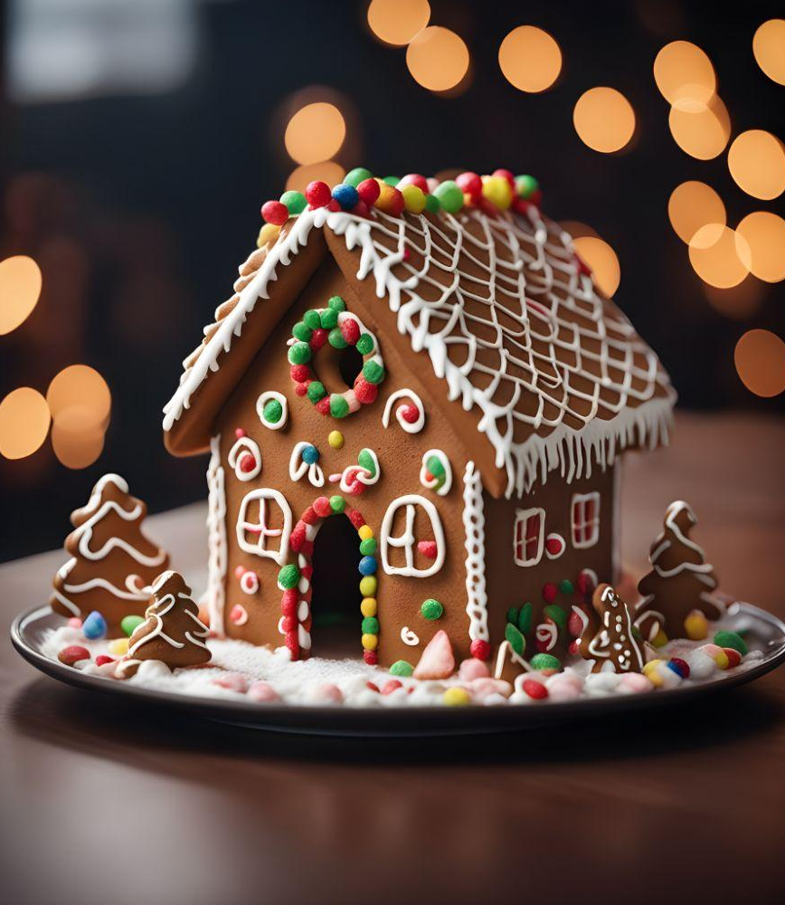
A picture always reinforces the concept
Images reveal large amounts of data, so remember: use an image instead of a long text. Your audience will appreciate it

Slide 25
02
Guide
You can enter a subtitle here if you need it

Slide 26
7,498,000
Big numbers catch your audience’s attention

Slide 27
723
125
320
Mercury is the closest planet to the Sun
Despite being red, Mars is a cold place
Venus is the second planet from the Sun

Slide 28
Benefits and health risks
25%
50%
25%
Mercury
Venus
Mars
It’s the closest planet to the Sun
Venus is the second planet from the Sun
Mars is actually a very cold place

Slide 29
Question and answer
Mercury
Venus
Mercury is the closest planet to the Sun and also the smallest one in the entire Solar System
Venus has a beautiful name and is the second planet from the Sun. It’s hot and has a poisonous atmosphere

Slide 30
Gingerbread house class
Su | M | T | W | Th | F | S
30 | 1 | 2 | 3 | 4 | 5 | 6
7 | 8 | 9 | 10 | 11 | 12 | 13
14 | 15 | 16 | 17 | 18 | 19 | 20
21 | 22 | 23 | 24 | 25 | 26 | 27
28 | 29 | 30 | 31 | 1 | 2 | 3
Course 1
Venus has a beautiful name but it’s very hot
Course 2
Despite being red, Mars is a cold place

Slide 31
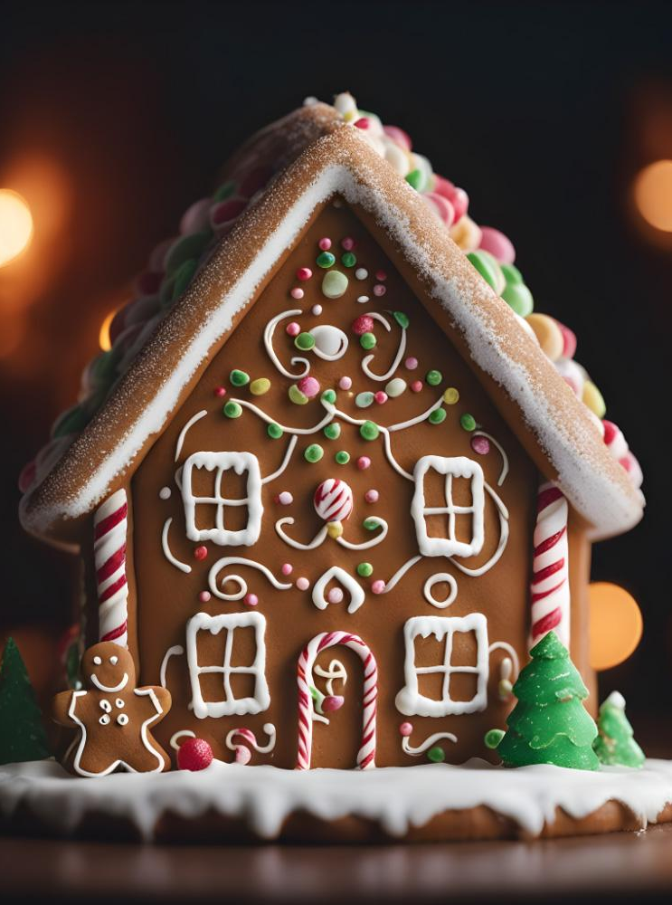
Tablet screenshot
You can replace the image on the screen with your own work. Just right-click on it and select “Replace image”

Slide 32
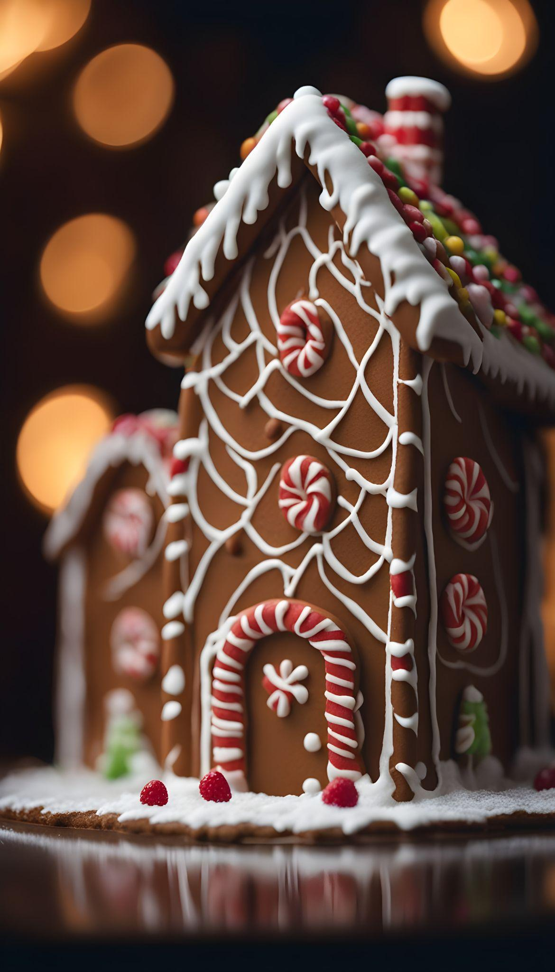
Mobile screenshot
You can replace the image on the screen with your own work. Just right-click on it and select “Replace image”

Slide 33
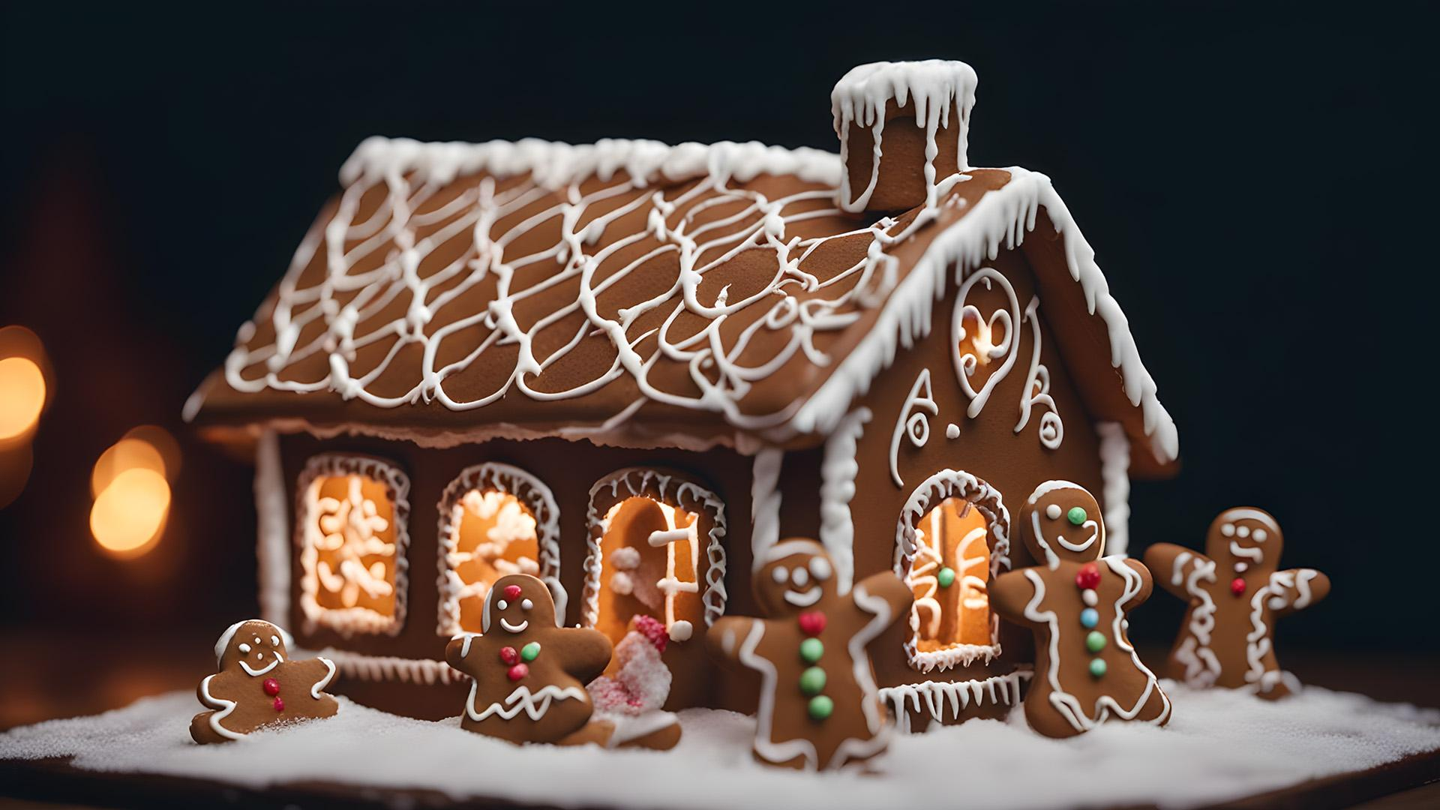
Desktop screenshot
You can replace the image on the screen with your own work. Just right-click on it and select “Replace image”

Slide 34
Gingerbread styles around the world
Mercury
Mercury is the closest planet to the Sun and the smallest planet in the Solar System

Slide 35


The mentors
Timmy Jimmy
Susan Bones
You can speak a bit about this person here
You can speak a bit about this person here

Slide 36
Gingerbread history
2XXX
2XXX
2XXX
2XXX
Mars
Mercury
Saturn
Venus
Despite being red, Mars is actually a cold place
Mercury is the closest planet to the Sun
Saturn is a gas giant and has several rings
Venus has a beautiful name, but is terribly hot

Slide 37
Stability and materials
Mars
Saturn
It is red, but it’s a very cold place
Saturn is a gas giant and has rings
Mercury
Venus
It is the closest planet to the Sun
Venus has a beautiful name

Slide 38
Gingerbread house engineering
Team | Problem | Progress so far | Problems
Members Responsibilities Gustav - training models Lauri & Martin - understanding data from a physics perspective | Predict power generation based on weather data To optimize the grid usage in the power plant | Data exploration - good plant, bad plant (LR plots) Inverters are failing - DCpower/IRR-ratio over time LRR Model - data cut | We don’t know where the bad values are coming from, illogical values? How and if to predict power output for malfunctioning inverters?
Mars is actually a very cold place | Venus has a beautiful name but is hot | Mercury is the smallest planet | Jupiter is the biggest planet of them all

Slide 39
Team | Problem | Progress | Blockers | Future steps
Gustav - training the models | -Predict power generation based on weather data -To optimize the grid usage in the power plant
Martin - Data understanding from a physics perspective
Lauri - understanding data from a physics perspective

Slide 40
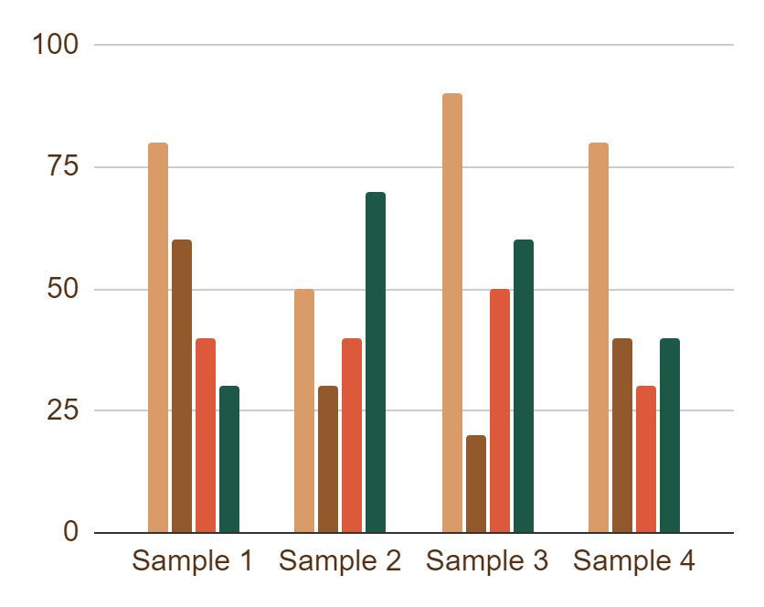
Fun facts and trivia
Saturn
Mars
Saturn is a gas giant and has several rings
Despite being red, Mars is actually cold
Venus
Mercury
Venus in fact has a very beautiful name
Mercury is the closest planet to the Sun
Follow the link in the graph to modify its data and then paste the new one here. For more info, click here

